Slide 1
DBMS DCL

Slide 2
Data Control Language
DCL includes commands such as GRANT and REVOKE which mainly deals with the rights, permissions and other controls of the database system.
High level user like DBA has power to grant access to database and its object.

Slide 3
GRANT-gives user’s access privileges to database.
REVOKE-withdraw user’s access privileges given by using the GRANT command.

Slide 4
Privileges
System Privileges:
Creating a table is type of system privilege
Object privilege:
To execute query on tables object privilege can be used.
Ownership privilege:
To execute query on tables created by same user.

Slide 5
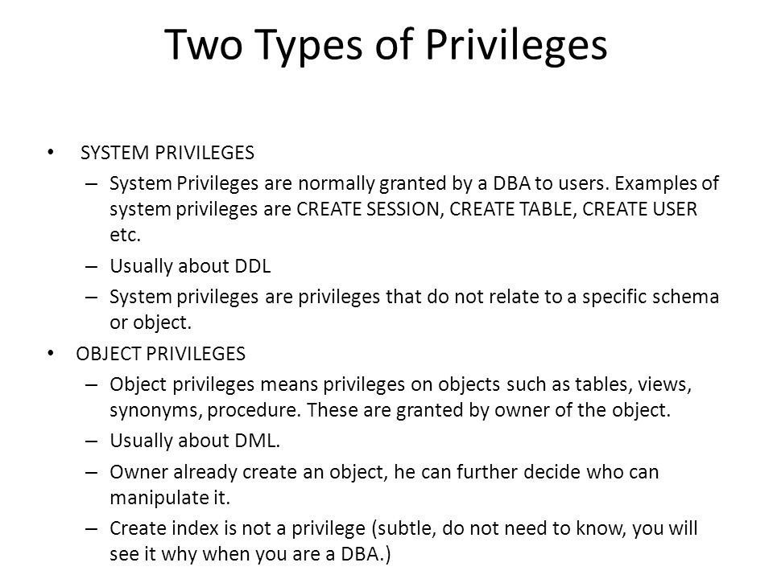

Slide 6
System privilege
System Privilege | Authorized to
CREATE USER | Create a number of user in DBMS
DROP USER | Drop any user in DBMS
Create any table | Create table object
Select any table | View any schema
Drop any table | Drop table in any schema

Slide 7
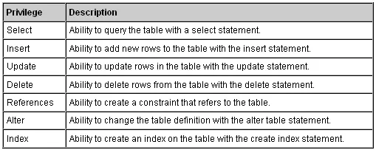
Object Privilege

Slide 8
Ownership privilege
When you create a database object(table) with create statement, you will become its owner and get full privileges for the table(select, create, update, delete and so on…)
All other users are having no privileges on your table.
You as a owner of database object can give grant privileges to any other user using GRANT statement.

Slide 9
Granting Privileges
An authorized user may pass authorization to other users. This process is called as granting privileges.

Slide 10
Syntax:
GRANT privileges_names ON object TO user;
Parameters Used:
privileges_name: These are the access rights or privileges granted to the user.
object: It is the name of the database object to which permissions are being granted. In the case of granting privileges on a table, this would be the table name.
user: It is the name of the user to whom the privileges would be granted.

Slide 11
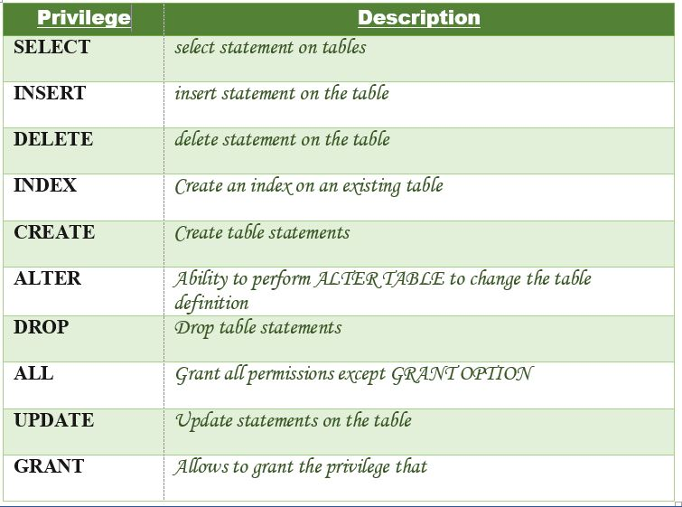

Slide 12
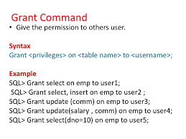
Different ways of granting privileges to the users

Slide 13
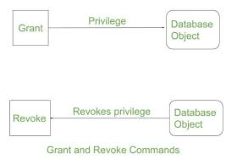

Slide 14
Revoking Privileges from a Table
The Revoke statement is used to revoke some or all of the privileges which have been granted to a user in the past.

Slide 15
Syntax:
REVOKE privileges ON object FROM user;
Parameters Used:
object: It is the name of the database object from which permissions are being revoked. In the case of revoking privileges from a table, this would be the table name.
user: It is the name of the user from whom the privileges are being revoked.

Slide 17

Different ways of revoking privileges from a user:

Slide 18
Revoking SELECT Privilege to a User in a Table:
REVOKE SELECT ON users FROM 'Amit';
Revoking more than Privilege to a User in a Table:
REVOKE SELECT, INSERT, DELETE, UPDATE ON Users FROM 'Amit’;

Slide 19
Thank you !
https://www.w3schools.com/sql/

